Slide 1
Tutorial on amortized optimization
github.com/facebookresearch/amortized-optimization-tutorial
Brandon Amos
Meta AI NYC, Fundamental AI Research (FAIR)
brandondamos
bamos.github.io
Collaborators: Noam Brown, Caroline Chen, Samuel Cohen, Arnaud Fickinger, Hengyuan Hu, Yann LeCun, Zeming Lin, Jason Liu, Giulia Luise, Joshua Meier, Ievgen Redko, Tom Sercu, Alexander Rives, Samuel Stanton, Shoba Venkataraman, Stuart Russel, Robert Verkuil, Andrew Gordon Wilson, Denis Yarats

Slide 2
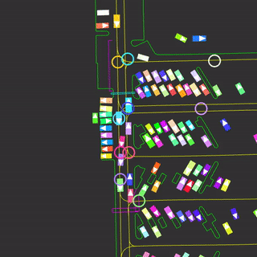
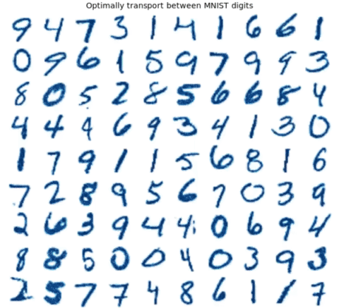
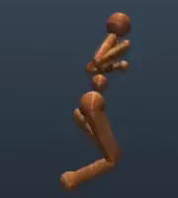
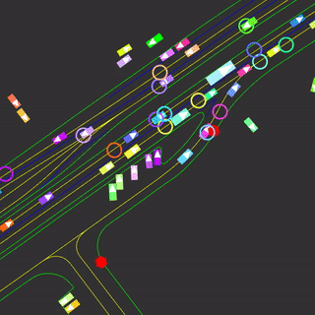
Optimization is a powerful modeling tool
Continuous optimization expresses many non-trivial operations
Control, reinforcement learning, robotics, geometry (projections), variational inference, finance (portfolio optimization), sparse coding, meta-learning, deep equilibrium networks, optimal transport, game and market equilibrium

Slide 3
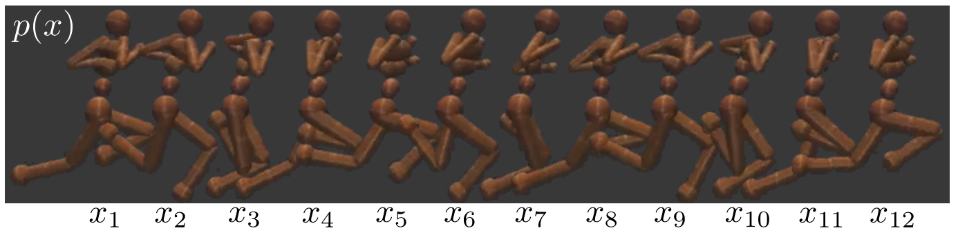
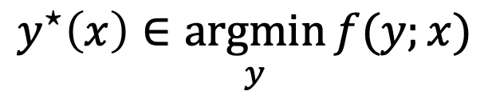
Repeatedly solving optimization problems
Optimization problems often do not live in isolation and are often repeatedly solved in deployment
$$y^{⋆}\left(x\right)∈\underset{y}{argmin}{f(y;x)}$$
Optimal solution
Optimization variable
Objective
Context
In control, $x$ is the system state, $y$ is the action, $f\left(y;x\right)$ is a cost, and $y^{⋆}(x)$ is an optimal action

Slide 4
Difficulty: optimization is computationally expensive
Sometimes solving just once may be difficult
Exasperated when repeatedly solving during deployment
Insight: optimal solutions share structure
Optimization problems share structure and don’t live in isolation
Solution: amortized optimization
Use machine learning to uncover the shared structure
Create learning-augmented versions of classical optimization solvers
Far surpasses average or worst-case convergence rates

Slide 5
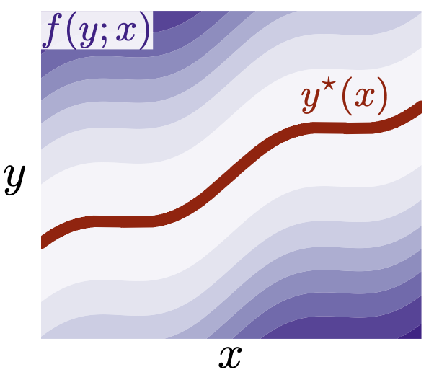
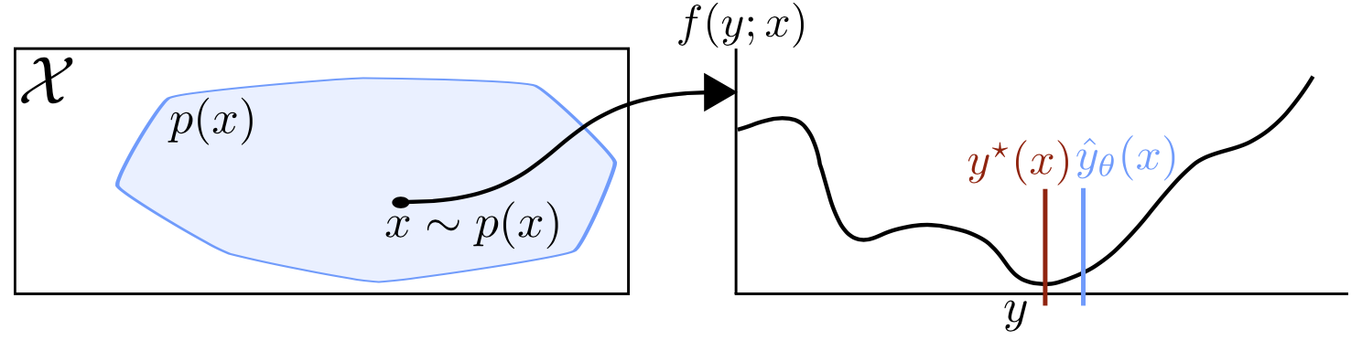
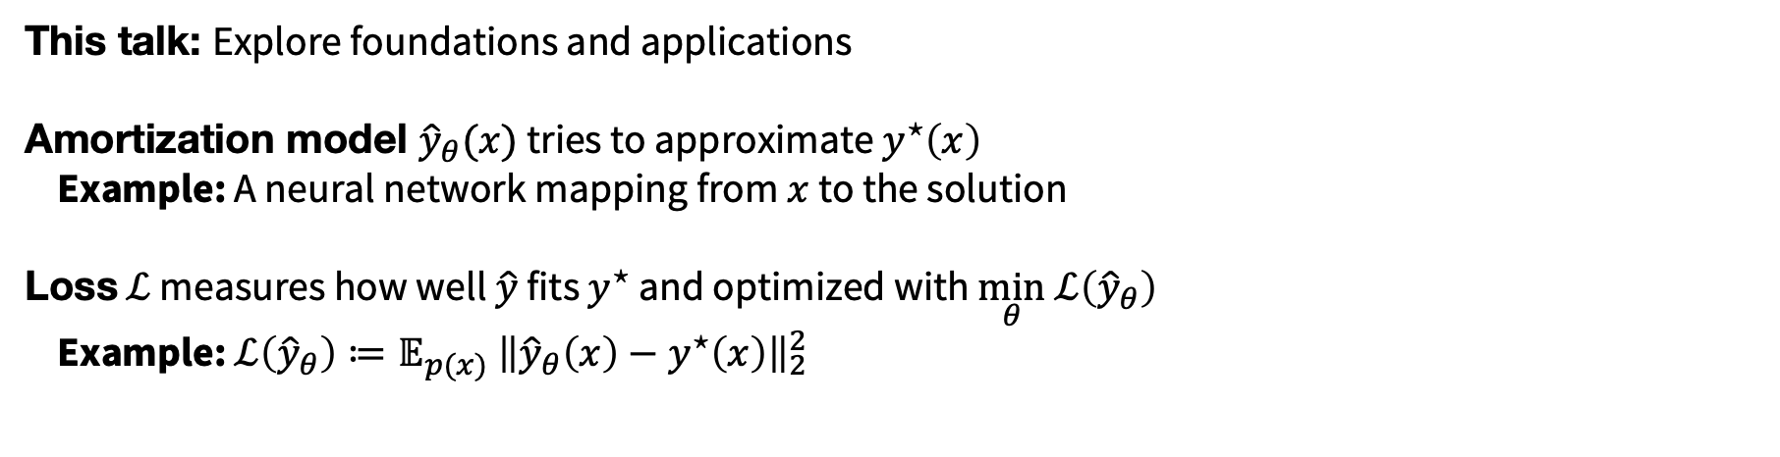
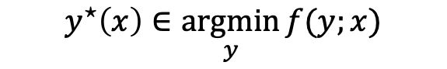
Amortized optimization foundations
This talk: Explore foundations and applications
Amortization model ${\hat{y}}_{θ}(x)$ tries to approximate $y^{⋆}\left(x\right)$
Example: A neural network mapping from $x$ to the solution
Loss $ℒ$ measures how well $\hat{y}$ fits $y^{⋆}$ and optimized with $\min_{θ} ℒ\left({\hat{y}}_{θ}\right)$
Example: $ℒ\left({\hat{y}}_{θ}\right)≔𝔼_{p(x)} {\left\|{\hat{y}}_{θ}\left(x\right)−y^{⋆}\left(x\right)\right\|}_{2}^{2}$
$$y^{⋆}\left(x\right)∈\underset{y}{argmin}{f(y;x)}$$
Notes:
TODO: Separate images, move earlier

Slide 6
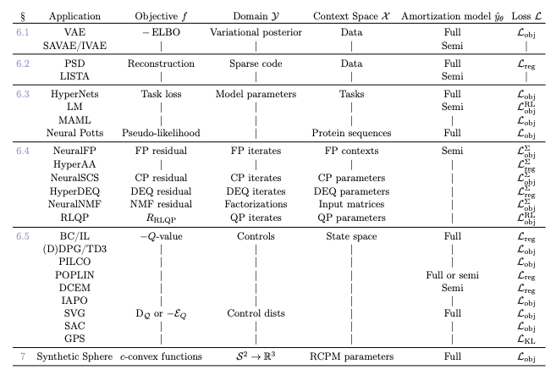
Amortized optimization is already ubiquitous
My goal: characterize and connect applications previously developed independently from each other

Slide 7
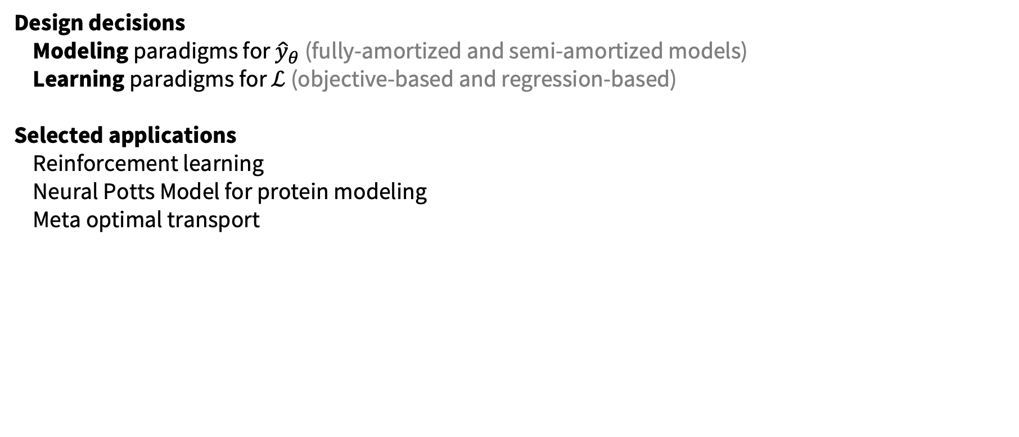
This talk: amortized optimization
Design decisions
Modeling paradigms for ${\hat{y}}_{θ}$ (fully-amortized and semi-amortized models)
Learning paradigms for $ℒ$ (objective-based and regression-based)
Selected applications
Reinforcement learning
Neural Potts Model for protein modeling
Meta optimal transport

Slide 8
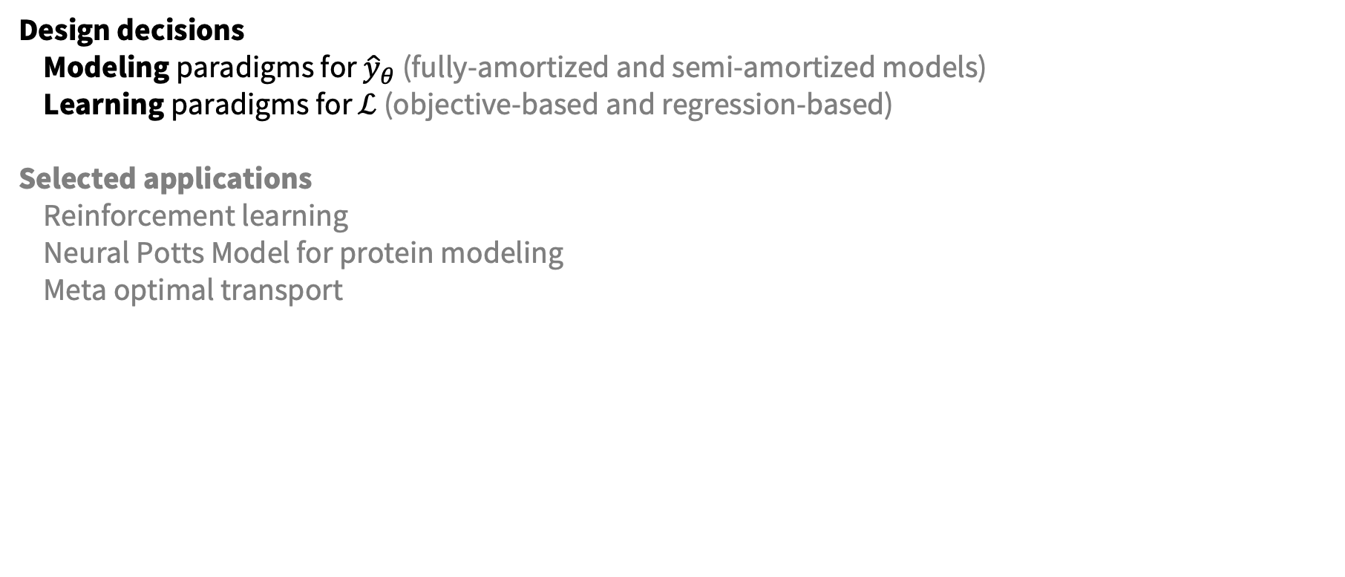
This talk: amortized optimization
Design decisions
Modeling paradigms for ${\hat{y}}_{θ}$ (fully-amortized and semi-amortized models)
Learning paradigms for $ℒ$ (objective-based and regression-based)
Selected applications
Reinforcement learning
Neural Potts Model for protein modeling
Meta optimal transport

Slide 9
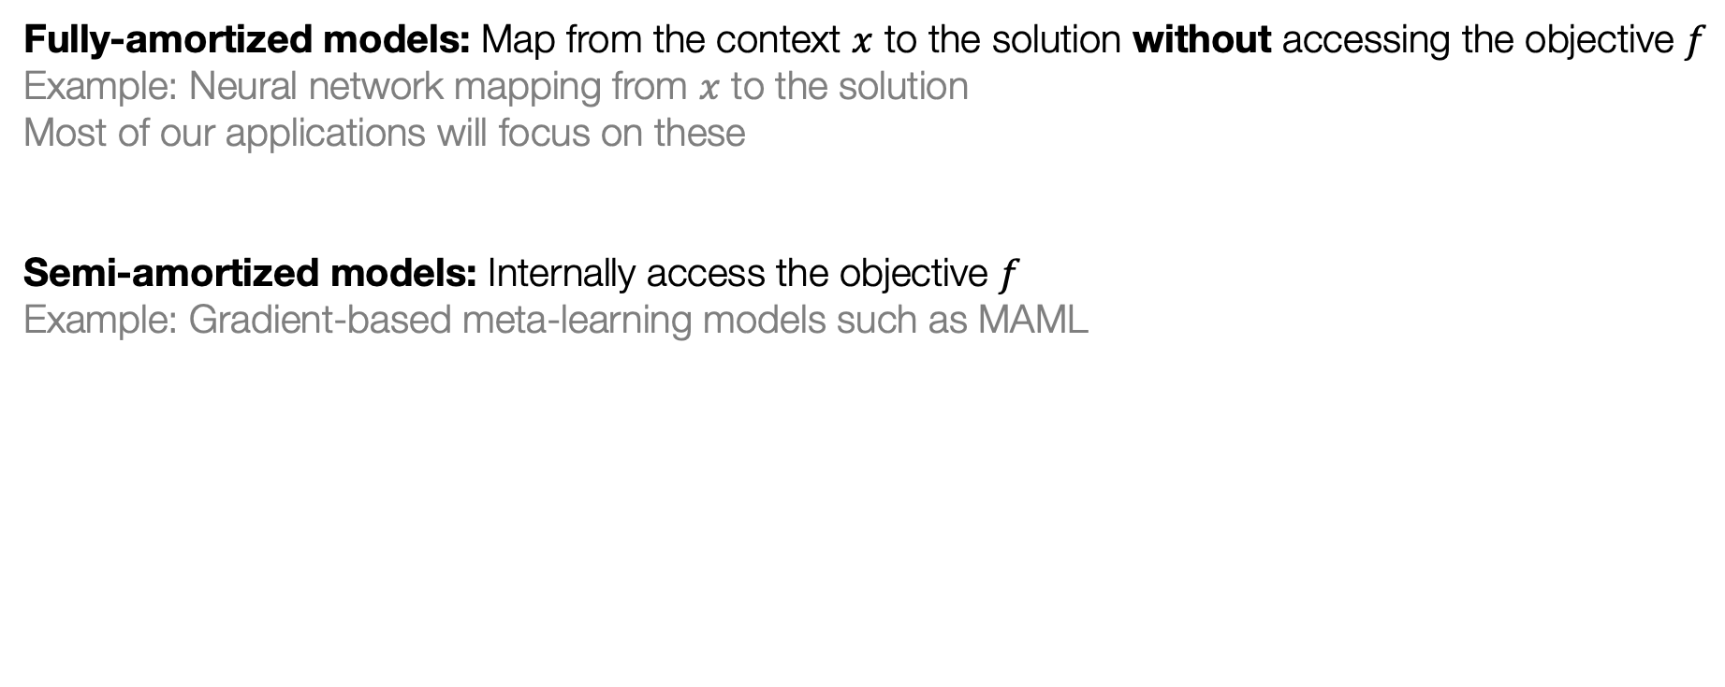

Modeling paradigms for ${\hat{y}}_{θ}$
How to best-predict the solution?
Fully-amortized models: Map from the context $x$ to the solution without accessing the objective $f$
Example: Neural network mapping from $x$ to the solution
Most of our applications will focus on these
Semi-amortized models: Internally access the objective $f$
Example: Gradient-based meta-learning models such as MAML

Slide 10
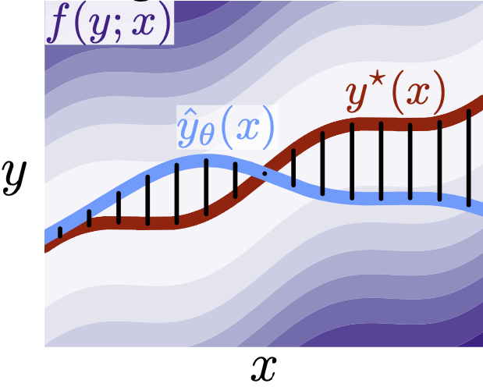
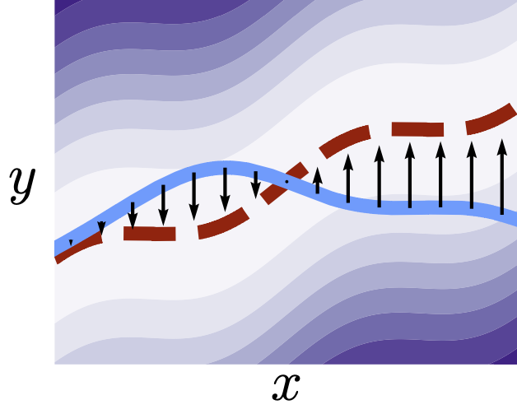
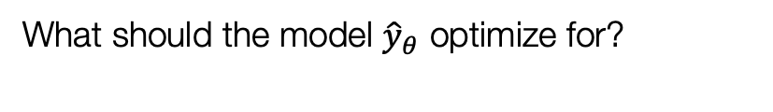
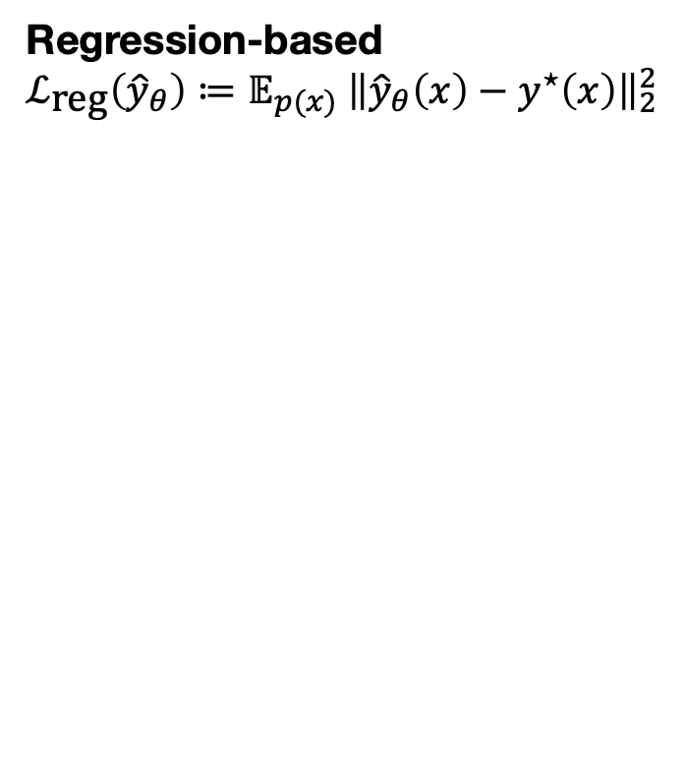

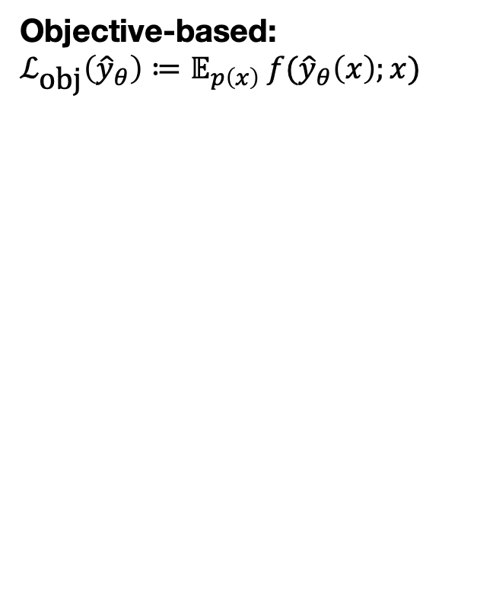
Learning paradigms for $ℒ$
What should the model ${\hat{y}}_{θ}$ optimize for?
Regression-based
$$ℒ_{\text{reg}}\left({\hat{y}}_{θ}\right)≔𝔼_{p(x)} {\left\|{\hat{y}}_{θ}\left(x\right)−y^{⋆}\left(x\right)\right\|}_{2}^{2}$$
Objective-based:
$$ℒ_{\text{obj}}\left({\hat{y}}_{θ}\right)≔𝔼_{p\left(x\right)} f({\hat{y}}_{θ}\left(x\right);x)$$

Slide 11
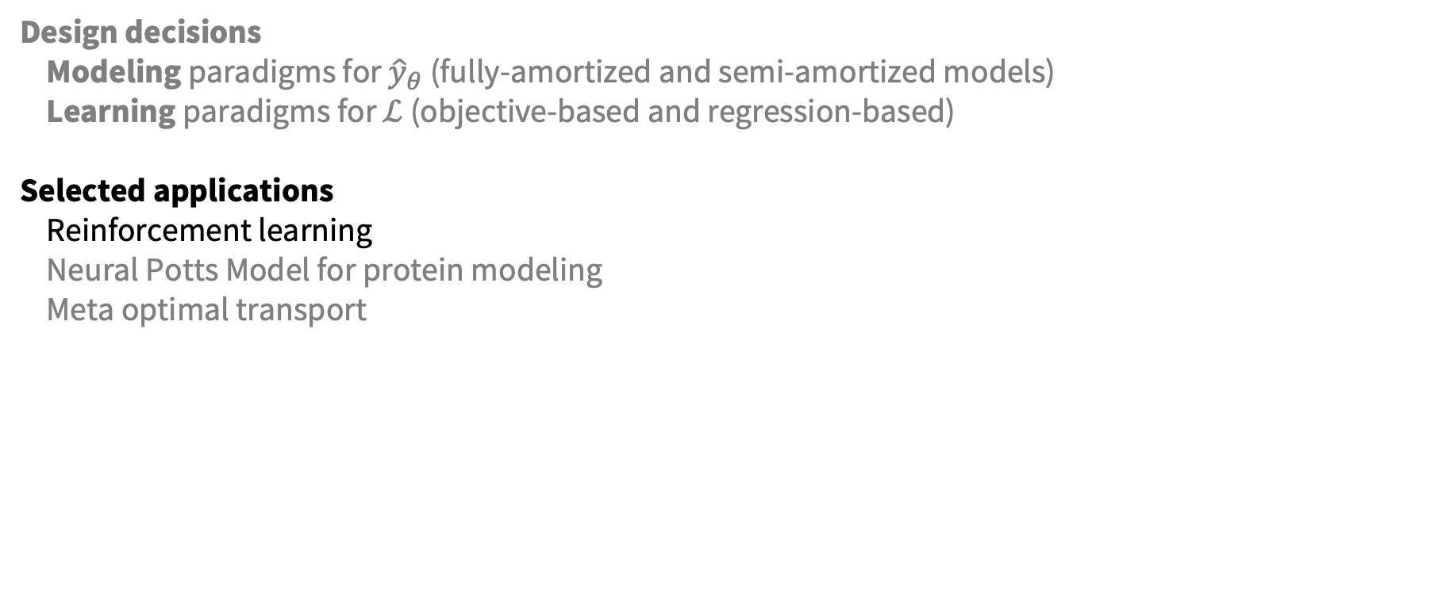
This talk: amortized optimization
Design decisions
Modeling paradigms for ${\hat{y}}_{θ}$ (fully-amortized and semi-amortized models)
Learning paradigms for $ℒ$ (objective-based and regression-based)
Selected applications
Reinforcement learning
Neural Potts Model for protein modeling
Meta optimal transport

Slide 12
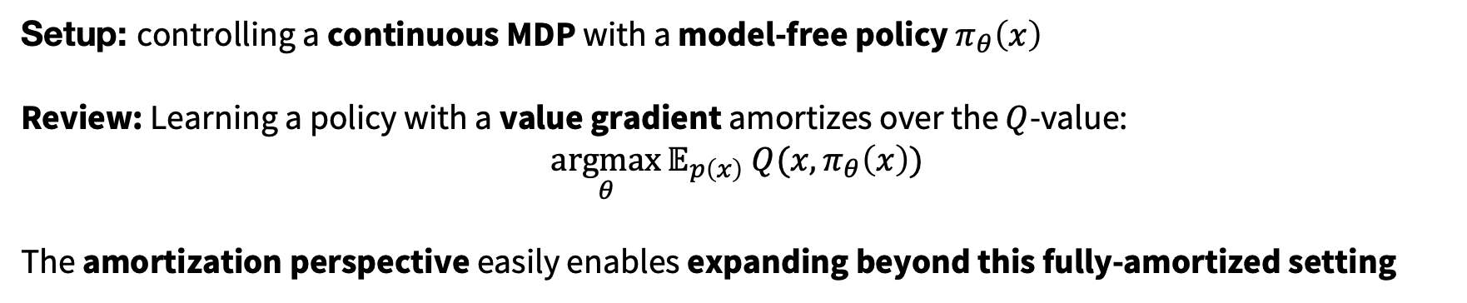
RL policy learning is amortized optimization
Setup: controlling a continuous MDP with a model-free policy $π_{θ}\left(x\right)$
Review: Learning a policy with a value gradient amortizes over the $Q$-value:
$$\underset{θ}{argmax}{𝔼_{p\left(x\right)} Q(x, π_{θ}\left(x\right))}$$
The amortization perspective easily enables expanding beyond this fully-amortized setting

Slide 13
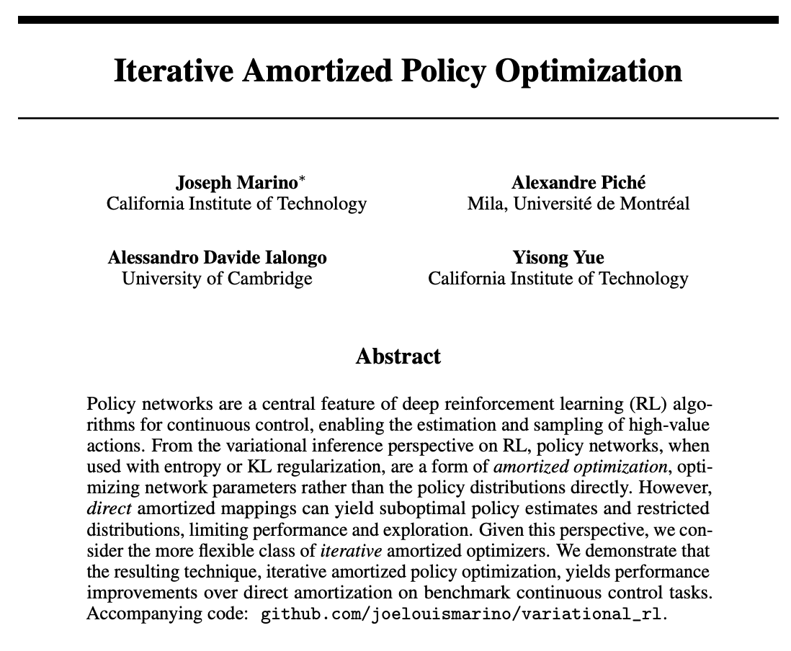
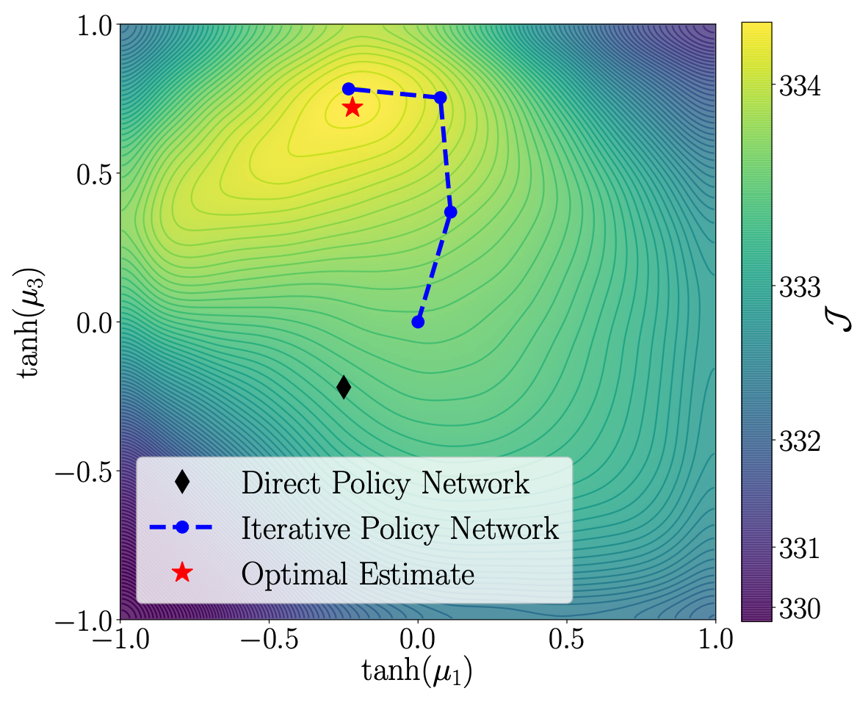
Semi-amortized policy learning

Slide 14
Decision-time fine-tuning and planning
Rely on standard policy methods such as PPO to amortize the solution to a game
Fine-tune at decision time by constraining to the initial state and continuing policy optimization
Hanabi scores
Ms. Pacman scores

Slide 15
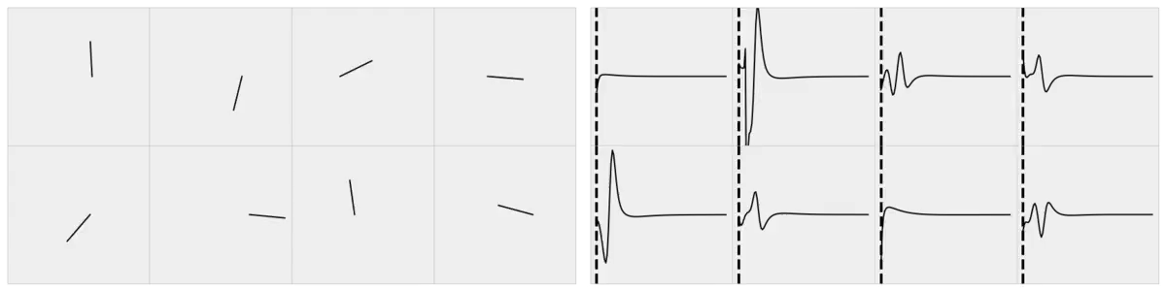
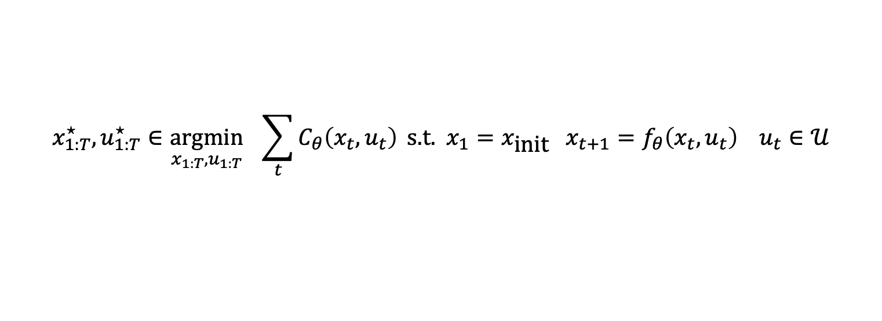
Amortization via learning latent subspaces
Full control sequence space
Amortize the problem by learning a latent subspace of optimal solutions
Only search over optimal solutions rather than the entire space
cost
initial state
dynamics
constraints
$${x_{1:T}^{⋆}, u}_{1:T}^{⋆}∈\underset{{x_{1:T}, u}_{1:T}}{argmin}{ \sum_{t}{C_{θ}\left(x_{t}, u_{t}\right)}} \text{s}\text{.}\text{t}\text{. }x_{1}=x_{\text{init}} x_{t+1}=f_{θ}\left(x_{t}, u_{t}\right) u_{t}∈𝒰$$
Subspace of optimal solutions
Cartpole videos
Optimal controls over time — force on the cartpole
Time

Slide 16
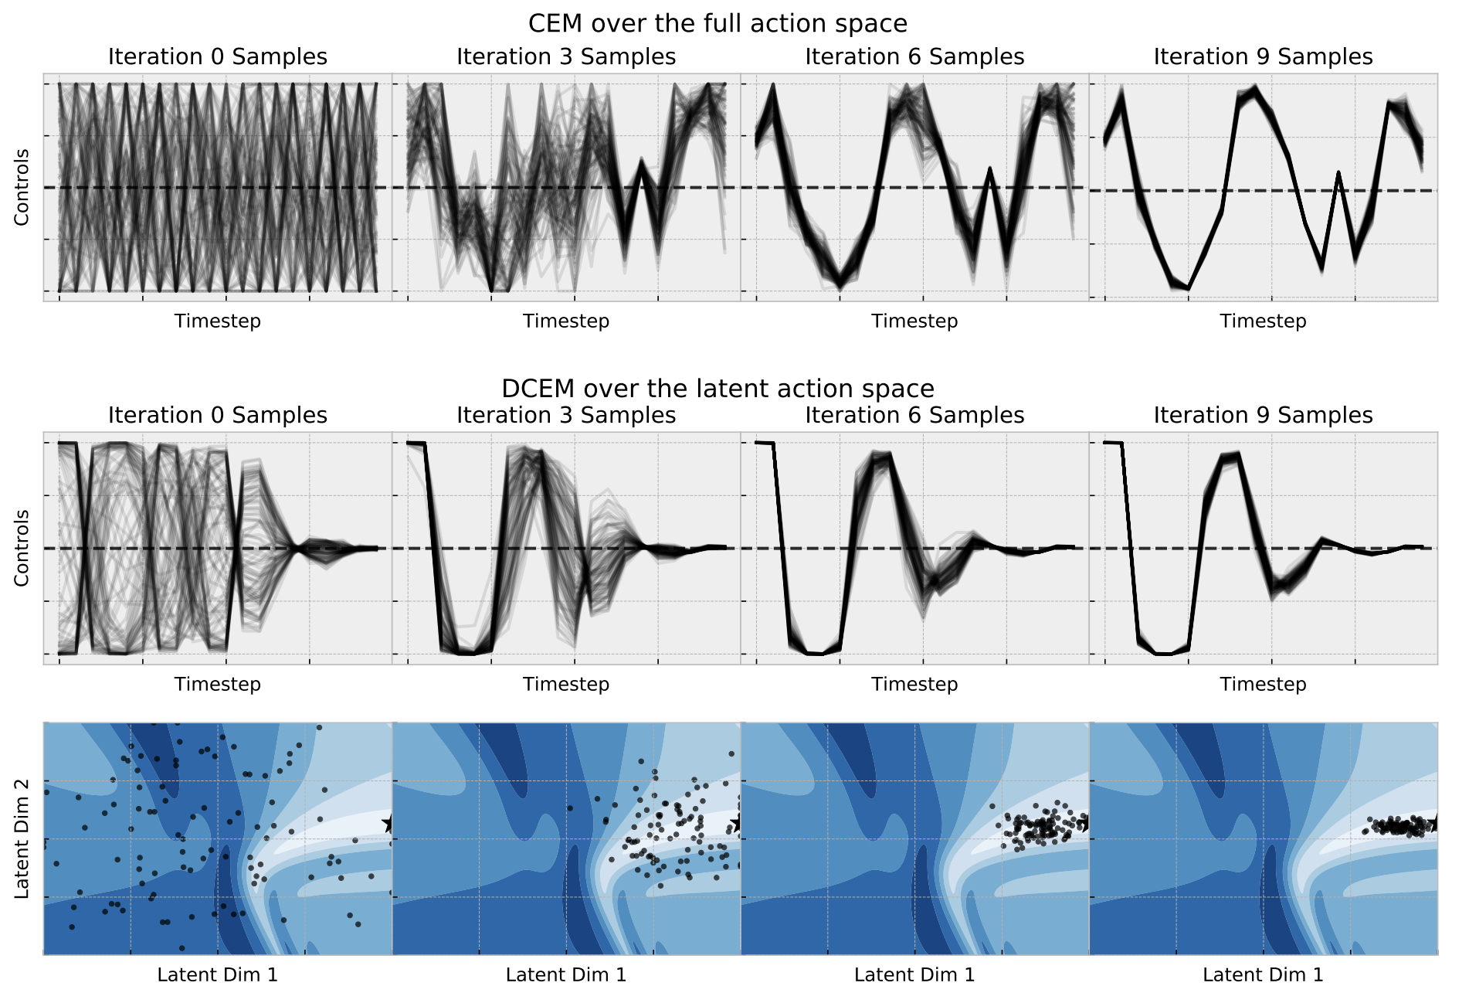
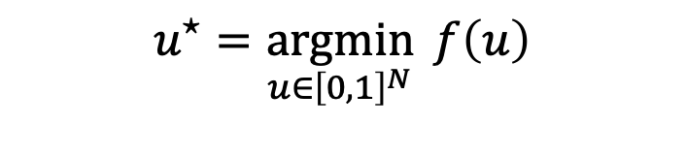
Amortization via learning latent subspaces
$$u^{⋆}=\underset{u∈{\left[0,1\right]}^{N}}{argmin}{f\left(u\right)}$$
Full control sequence space
Subspace of optimal solutions
Latent space of optimal solutions

Slide 17

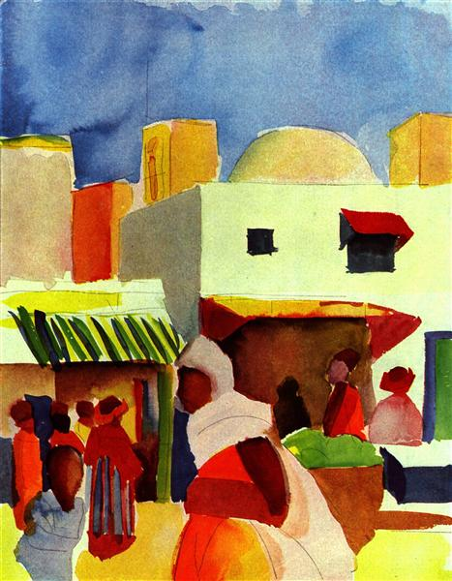
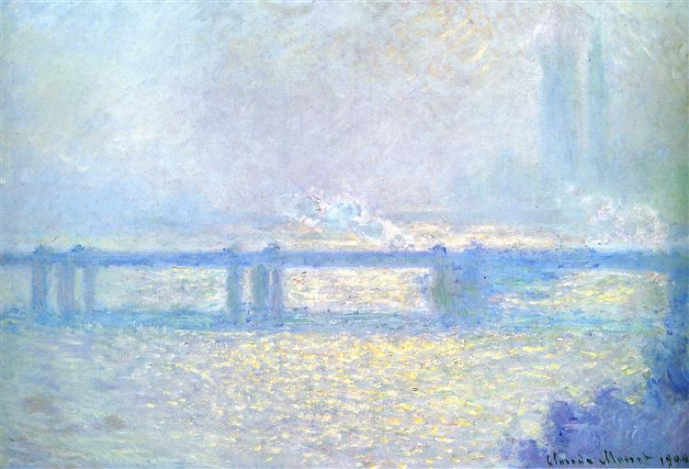
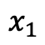
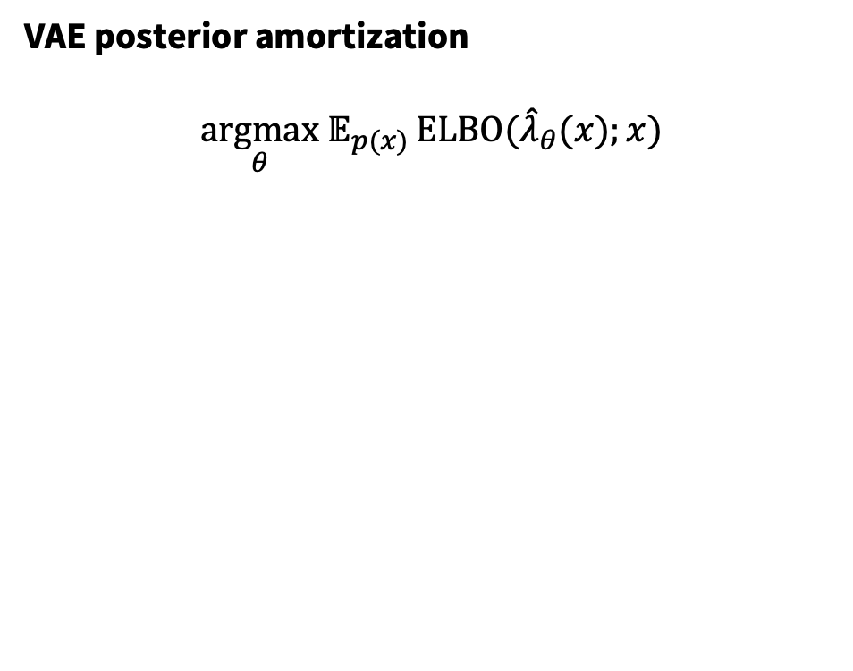
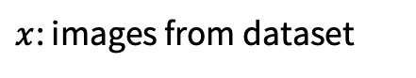
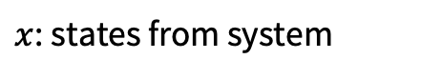
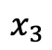
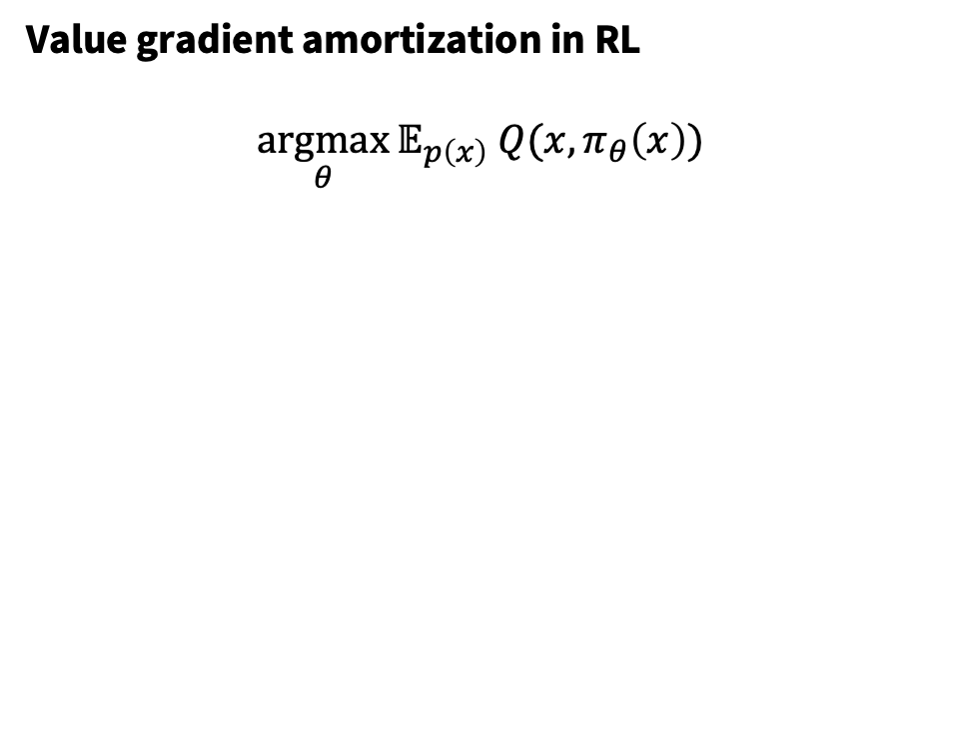
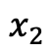
VAE amortization is conceptually the same as RL
Value gradient amortization in RL
$$\underset{θ}{argmax}{𝔼_{p\left(x\right)} Q(x, π_{θ}\left(x\right))}$$
VAE posterior amortization
$$\underset{θ}{argmax} 𝔼_{p(x)}{\text{ELBO}({\hat{λ}}_{θ}(x);x)}$$
$x$: states from system
$x$: images from dataset
$$x_{1}$$
$$x_{2}$$
$$x_{3}$$

Slide 18
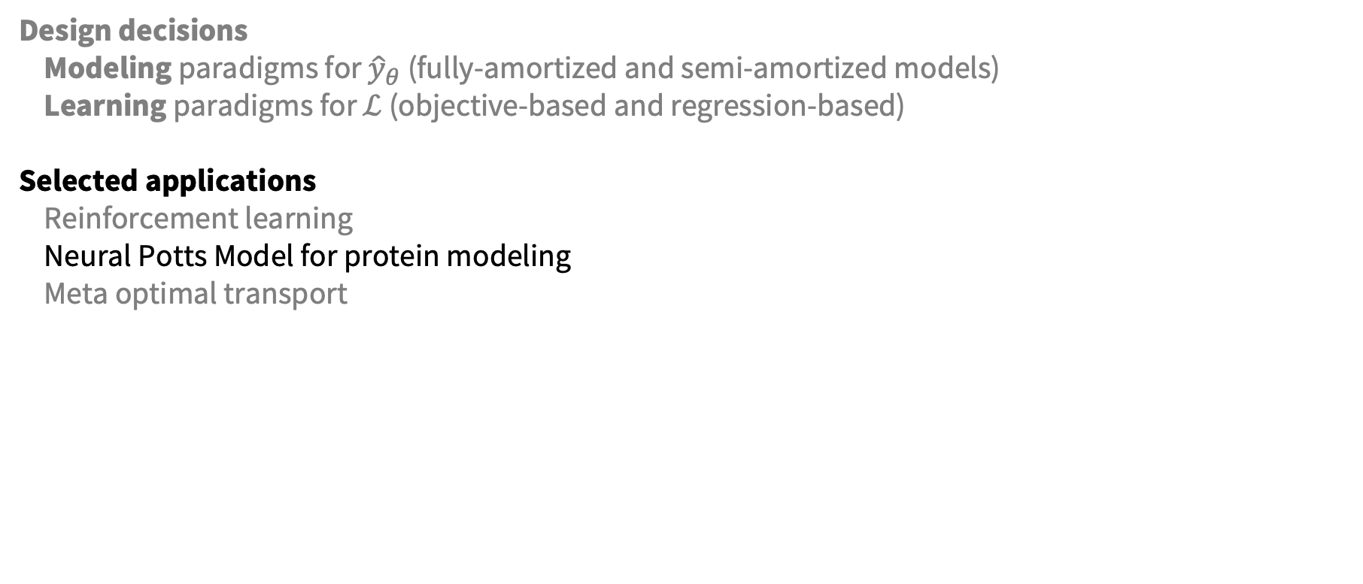
This talk: amortized optimization
Design decisions
Modeling paradigms for ${\hat{y}}_{θ}$ (fully-amortized and semi-amortized models)
Learning paradigms for $ℒ$ (objective-based and regression-based)
Selected applications
Reinforcement learning
Neural Potts Model for protein modeling
Meta optimal transport

Slide 19
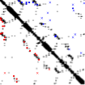
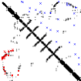
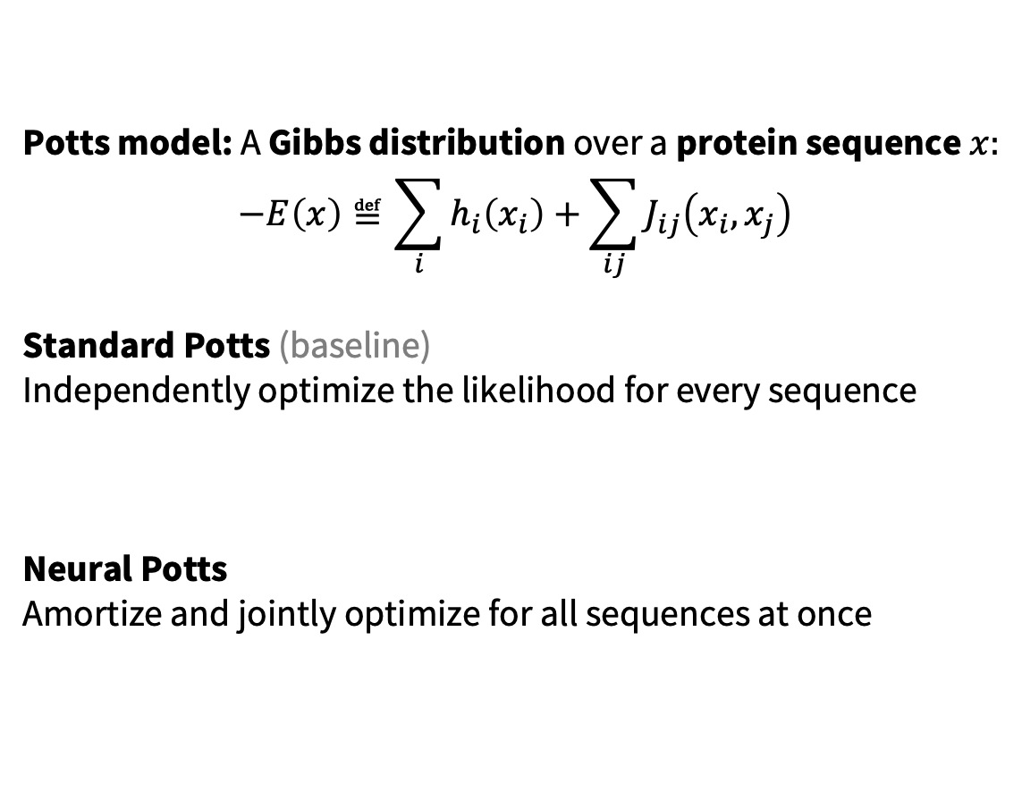
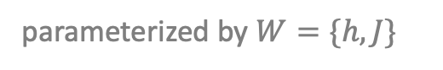
Neural Potts Model
Potts model: A Gibbs distribution over a protein sequence $x:$
$$−E\left(x\right)≝\sum_{i}{h_{i}\left(x_{i}\right)+\sum_{ij}{J_{ij}\left(x_{i}, x_{j}\right)}}$$
Standard Potts (baseline)
Independently optimize the likelihood for every sequence
Neural Potts
Amortize and jointly optimize for all sequences at once
parameterized by $W=\{h,J\}$
Contact predictions

Slide 20
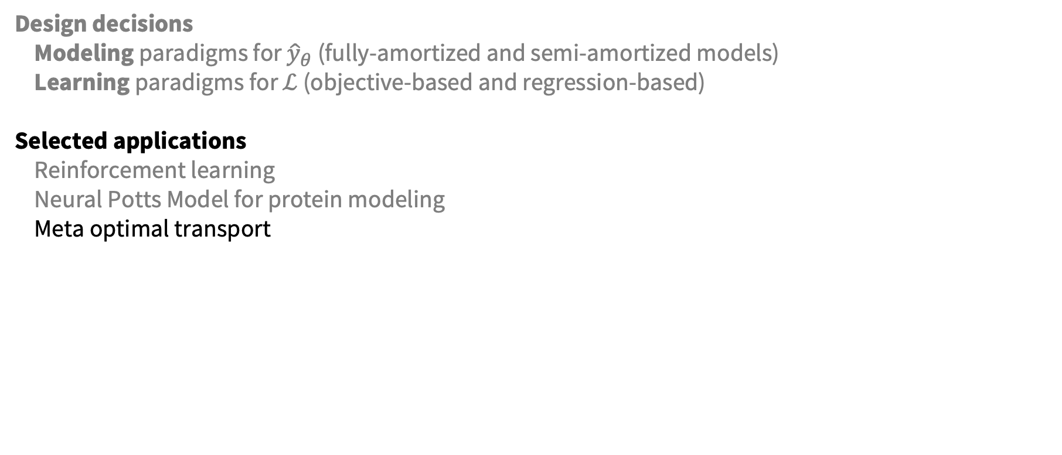
This talk: amortized optimization
Design decisions
Modeling paradigms for ${\hat{y}}_{θ}$ (fully-amortized and semi-amortized models)
Learning paradigms for $ℒ$ (objective-based and regression-based)
Selected applications
Reinforcement learning
Neural Potts Model for protein modeling
Meta optimal transport

Slide 21
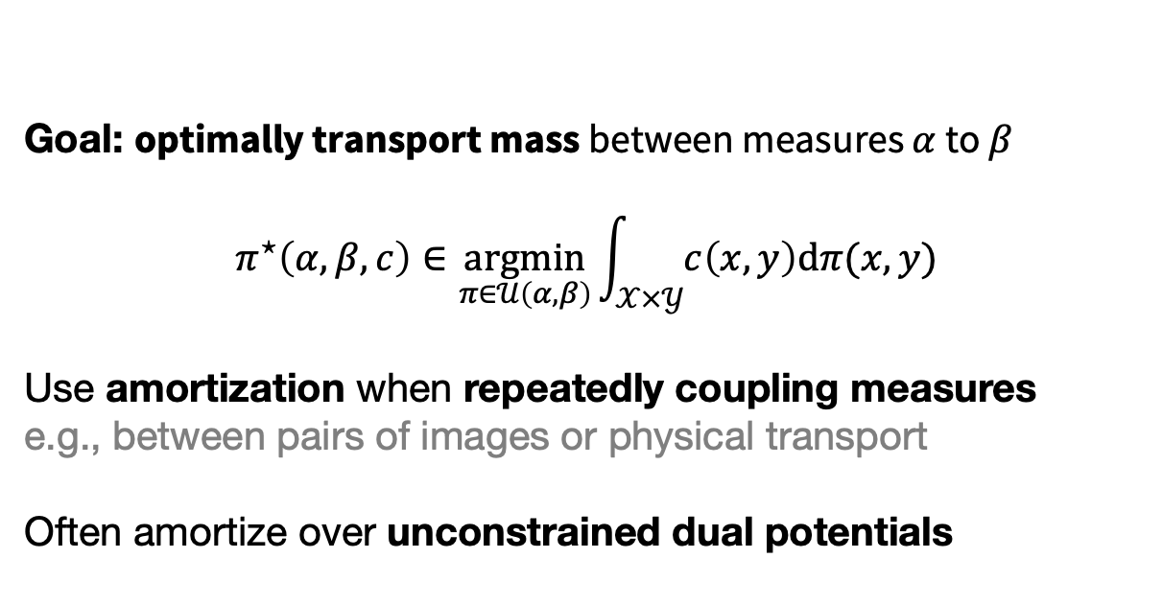
Meta Optimal Transport
Goal: optimally transport mass between measures $α$ to $β$
$$π^{⋆}\left(α, β, c\right)∈\underset{π∈𝒰\left(α, β\right)}{argmin}{\int_{𝒳×𝒴}{c\left(x,y\right)\text{d}π(x,y)}}$$
Use amortization when repeatedly coupling measures
e.g., between pairs of images or physical transport
Often amortize over unconstrained dual potentials

Slide 22
Meta Optimal Transport
Predict couplings 100x faster than SOTA solvers that doesn’t use learning

Slide 23
More meta color transfer predictions

Slide 24
Future directions and limitations
Amortized optimization is established and budding with new methods and applications
Possible to expand far beyond unconstrained continuous Euclidean optimization settings:
1. New applications and settings for semi-amortized modeling
2. Constrained domains (e.g., with differentiable projections)
3. Discrete optimization settings (e.g., with differentiable discrete optimization)
4. Non-Euclidean settings (e.g., with Riemannian optimization)
Potential limitations:
1. Difficult in out-of-domain settings when the contexts significantly change
2. Generally difficult to ensure stability or convergence
3. Typically does not solve previously intractable problems
4. Can be difficult to obtain high-accuracy solutions without fine-tuning/semi-amortization

Slide 25
Tutorial on amortized optimization
github.com/facebookresearch/amortized-optimization-tutorial
Brandon Amos
Meta AI NYC, Fundamental AI Research (FAIR)
brandondamos
bamos.github.io
The differentiable cross-entropy method [Amos and Yarats, ICML 2020]
Neural Potts Model [Sercu*, Verkuil*, et al., MLCB 2020]
On the model-based stochastic value gradient [Amos, Stanton, Yarats, Wilson, L4DC 2021]
Online planning via RL fine-tuning [Fickinger*, Hu*, et al., NeurIPS 2021]
Neural fixed-point acceleration [Venkataraman and Amos, ICML AutoML Workshop, 2021]
Meta Optimal Transport [Amos, Cohen, Luise, Redko, arXiv 2022]
Tutorial on amortized optimization [Amos, arXiv 2022]
Collaborators: Noam Brown, Caroline Chen, Samuel Cohen, Arnaud Fickinger, Hengyuan Hu, Yann LeCun, Zeming Lin, Jason Liu, Giulia Luise, Joshua Meier, Ievgen Redko, Tom Sercu, Alexander Rives, Samuel Stanton, Shoba Venkataraman, Stuart Russel, Robert Verkuil, Andrew Gordon Wilson, Denis Yarats

Slide 26
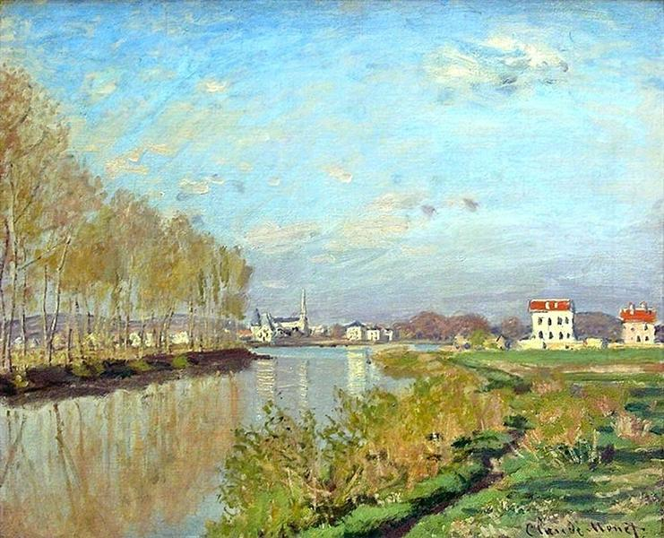
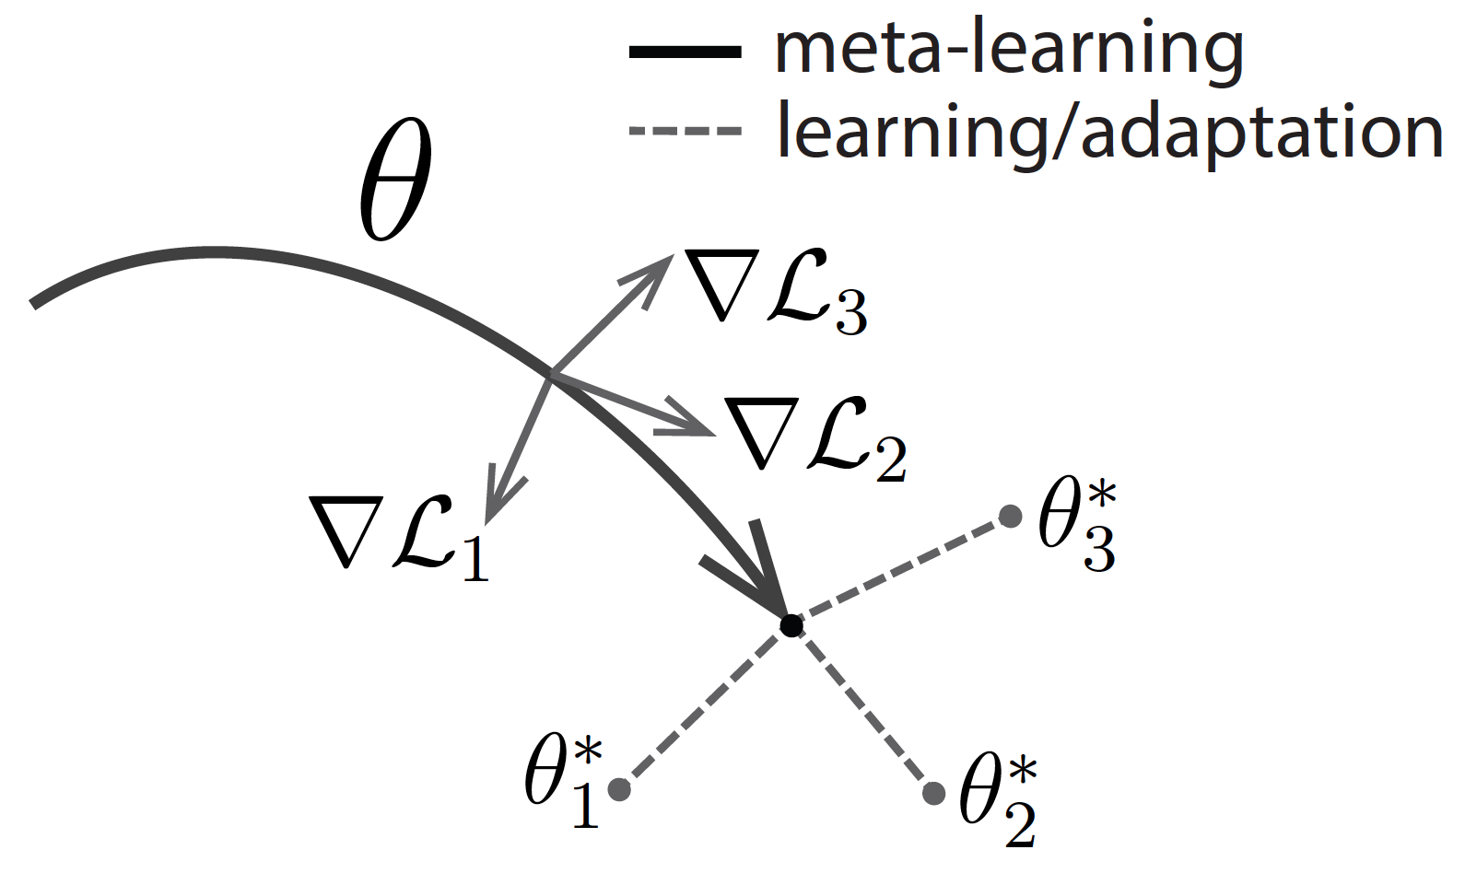
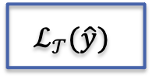
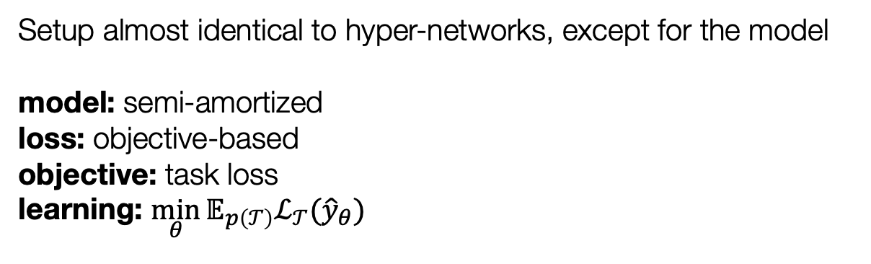
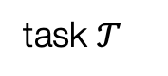
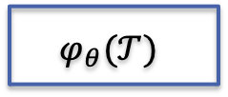
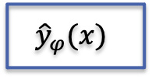
MAML as amortized optimization
task $𝒯$
hyper-network
network
task loss
$$φ_{θ}(𝒯)$$
$${\hat{y}}_{φ}(x)$$
$$ℒ_{𝒯}(\hat{y})$$
Setup almost identical to hyper-networks, except for the model
model: semi-amortized loss: objective-based
objective: task loss
learning: $\min_{θ}{𝔼_{p\left(𝒯\right)}ℒ_{𝒯}({\hat{y}}_{θ})}$

